Slide 1

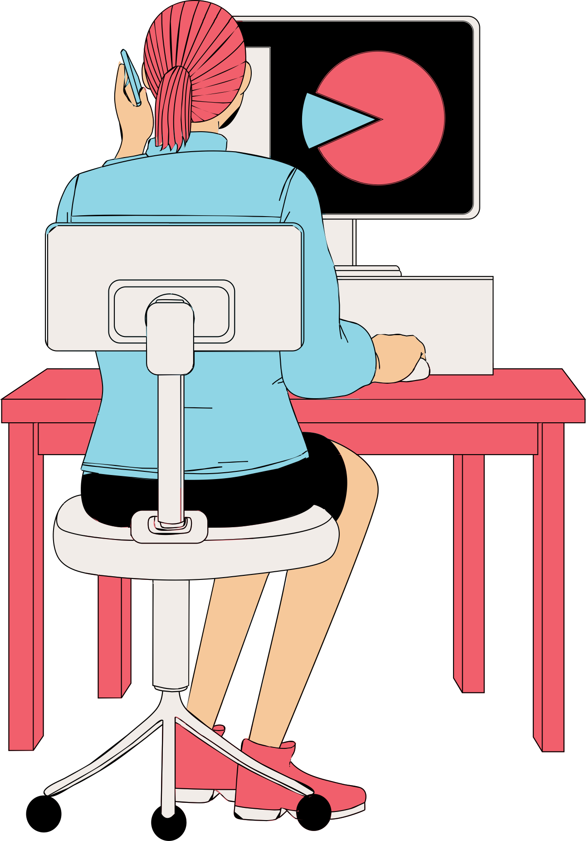
CHATGPT - SENTIMENT ANALYSIS AND REVIEW SCORE PREDICTIONS
Text Mining - for Business Uses
Uriel Bender - 205837131
Tal Lavi - 208662395

Slide 2

RESEARCH QUESTION
How can we predict the rating score (scale of 1-5) of user reviews for the ChatGPT app on Android devices to better understand and enhance customer satisfaction?
Business Use Cases:
Real-Time Monitoring: Track sudden changes in user ratings to identify unusual trends.
Bug Detection: Detect UI issues, algorithm malfunctions, or performance problems through rating patterns.
Rapid Response: Enable quick action on technical or user experience issues identified from rating trends.
Continuous Improvement: Drive app enhancements using insights from user ratings.

Slide 3
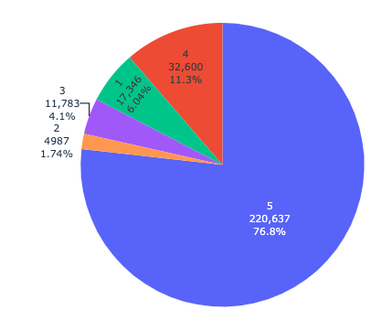

SCORE DISTRIBUTION
The graph shows a Bar Chart illustrating the distribution of the scores in the dataset. Most reviews receive a score of 5 (very positive), highlighting a significant data imbalance. This imbalance may bias the model towards predicting higher scores more accurately, while lower scores might be less well-predicted.

Slide 4
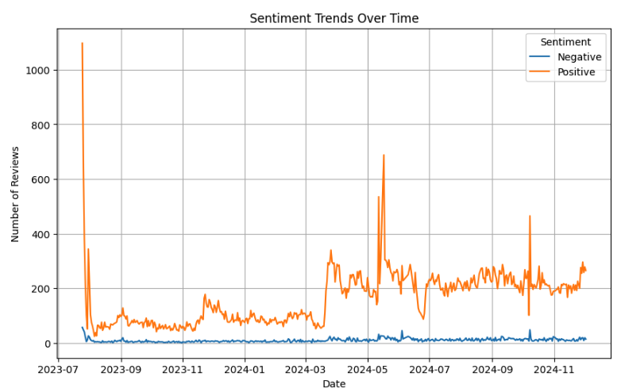
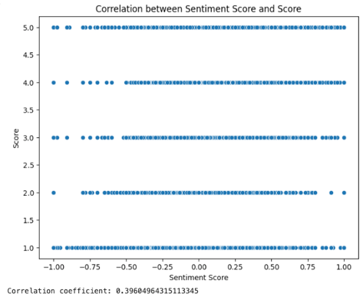
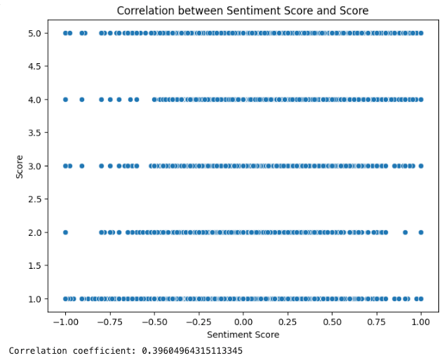

SCORE VS SENTIMENT SCORE
CORROLATION & TRENDS
Quite surprisingly, although most of the sentiments was positives the correlation between the variable created using the textblob model (sentiment_score) and the target variable can be seen to be relatively low.

Slide 5
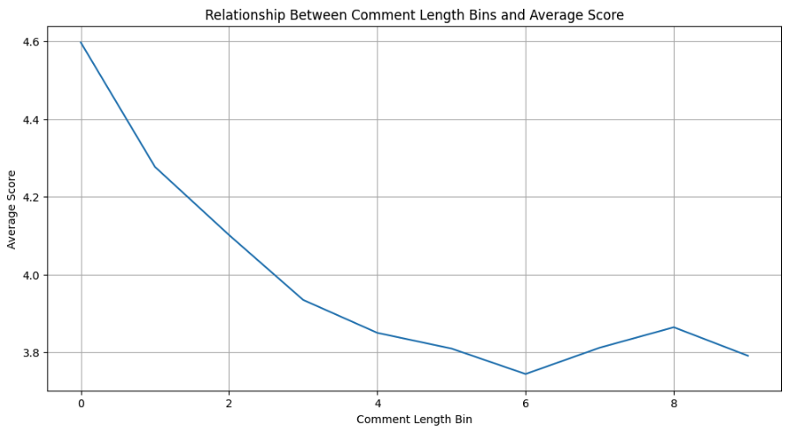
AVERAGE SCORE VS COMMENT LENGTH
Relationship between the Avg score to the comment length made us believed that this column added in the preprocess will help the model to improve the classifications later

Slide 6
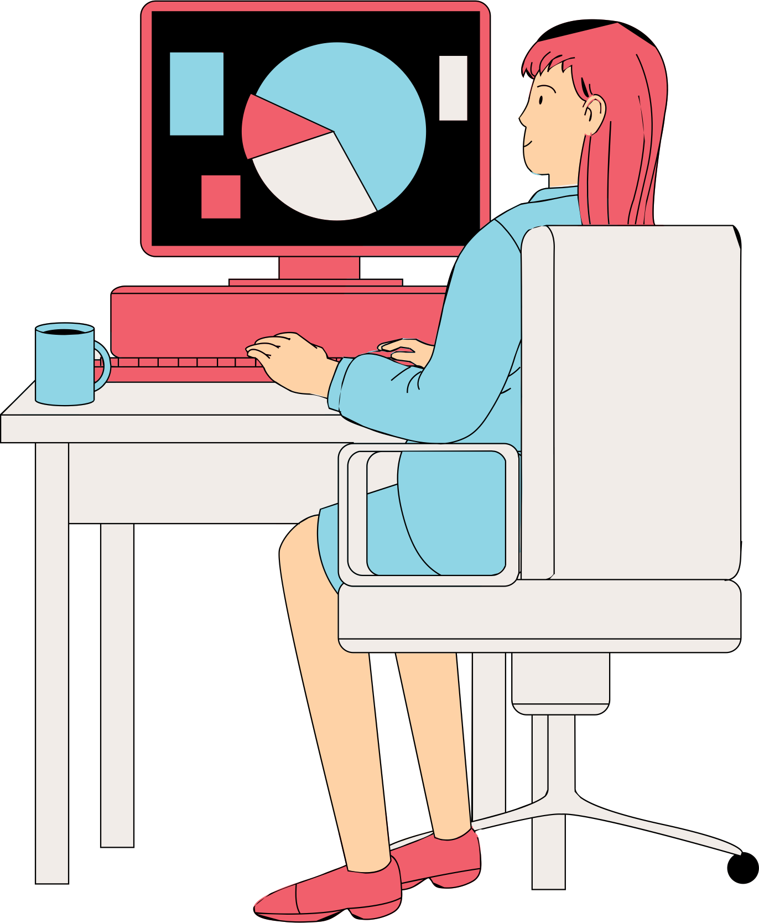
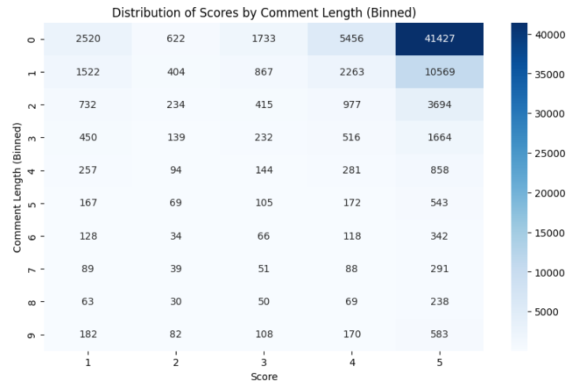
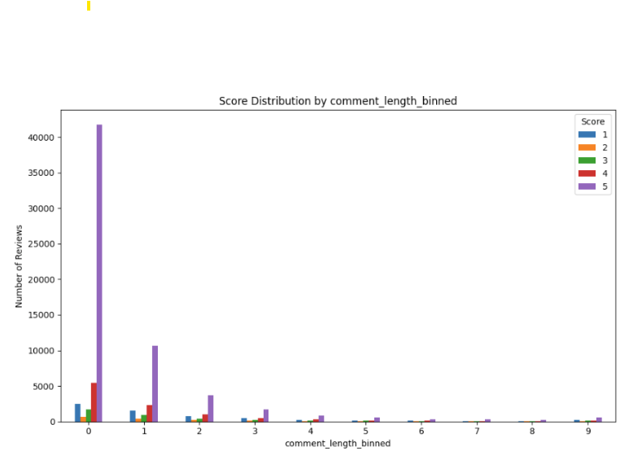
DISTRIBUTION OF SCORES BASED ON COMMENT LENGTH
Heatmap illustrating the distribution of scores (1-5) based on comment length (divided into bins).
Very Short Comments: Tend to be positive, frequently receiving a score of 5.
Longer Comments: Often reflect detailed feedback or more complex experiences, resulting in fewer high scores.
Data Imbalance: Most comments are short and positive, with a score of 5, which may create a bias in the model toward accurately predicting higher scores.

Slide 7

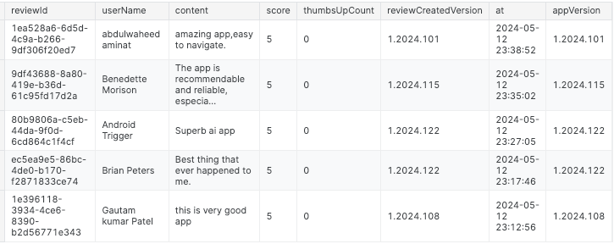
MODEL IMPLEMENTATION
EDA & Preprocess
DataSet info
Raw DataSet
 | # Features | # rows | Target variable
before pre-process | 7 | 287,352 | Score (1-5)
after preprocess | 12 | 81,947 | Score (1-5)
2500 duplicate records were identified and removed.
dropping and adding new features
Handel missing values
features dropped | reviewCreatedVersion, thumbsUpCount, appVersion, reviewId, UserName
features added | appVersion_numeric, sentiment,sentiment_score, month, user_reivew_count, comment_length_binned, day_of_week, cleaned_content (using old schoole NLP)
user Name - 2 | content - 9 | reviewCreatedVersion - 24915 | app Version numeric 24915
removed | removed | Due to a perfect correlation, with the appVersion column the 'reviewCreatedVersion' column was eliminated. | imputing the most frequent value

Slide 8
MODEL IMPLEMENTATION
NLP + Models Implementations
NLP
Models Implementations
lower case | Done in the preprocessing, seems to be added that is not relevant
remove punctuation | Done, not relevant Keep punctuation marks in comments (short text) it seemed important to leave exclamation marks (!) so as not to break the intonation.
remove stop words + other words | Done + Additional words were added to the list of stop words such as 'app', 'chatgpt' which appeared with high frequency
stemming | Done, the root of a word is semantically very close in every aspect, so there is no meaning to the grammar, etc., to the task
TextBlob for adding sentiment and sentiment Score features to empower the untextual data
TF-IDF + GradientBoostingClassifier
distilbert-base-uncased (pre-traind from huggingface) + GradientBoostingClassifier
Some version with xgb / random forests /logeisticregression - poor results
(almost) fine-tuned distilbert-base-uncased (pre-traind from huggingface) + GradientBoostingClassifier

Slide 9
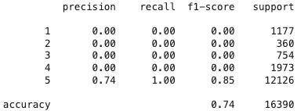
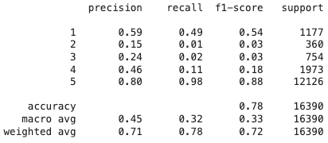
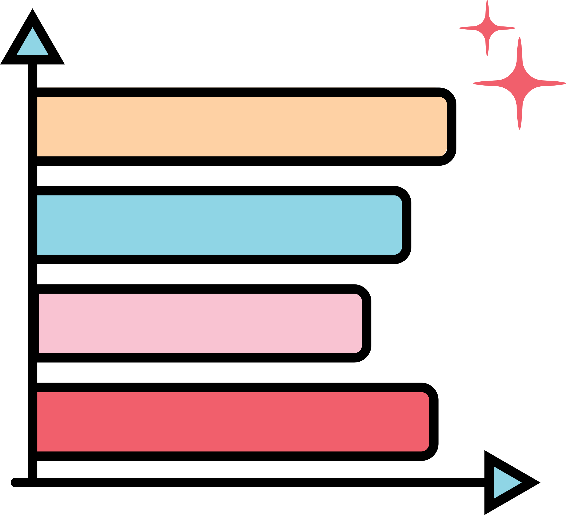

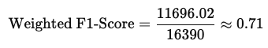
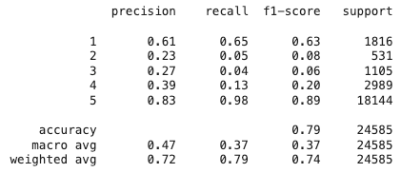
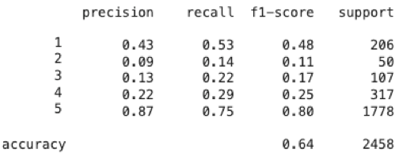

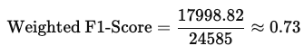
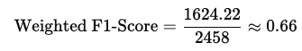
MAIN FINDINGS
Model Benchmark prediction
Tfidf + un-textual features
*using sklearn DummyClassifier
pre trained distilbert + un-textual features
pre trained distilbert + un-textual features + SMOTE
*using distilbert-base-uncased
(ignoring case sensitivity)
*using distilbert-base-uncased This results made on 10% of the data (time limitations)

Slide 10
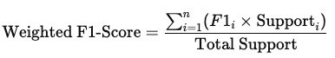

CONCLUSION
The model’s performance measures aligned with the skewed distribution of scores, performing less well on lower-rated responses due to limited data.
While trained models were explored, the simpler TF-IDF approach proved competitive. (0.71 vs 0.73 - overall f1)
The inclusion of supplementary features was crucial for enhancing the model’s ability to generalize to unseen data.
→ Was the best in the pre trained distilbert + un-textual features
Our performance measures will be Weighted F1-Score for overall performance evaluation which is the best avaluation for imbalnced data as we faced here .
Monitor Recall specifically for low ratings (1-2 stars) to ensure you don't miss out on unhappy users. This combination ensures that both detecting and acting on low ratings are prioritized while maintaining balanced performance.

Slide 11
RESEARCH LIMITATIONS
The dynamic nature of the dataset, updated daily, necessitates frequent retraining of the model to accommodate significant ranking shifts resulting from new version releases.
Limiting our analysis to English may have introduced a language bias, as we missed valuable insights from different linguistic contexts and cultural nuances.
To ensure timely project completion within the given resource constraints, we had to reduce the dataset size by approximately 50% (and even up to 90%)

Slide 12


ANY
QUESTIONS?
Thank you
for listening

